Slide 1
CSC 101 : Introduction to Computer Science
Department of Computer Science
College of Physical Sciences
Federal University of Agriculture, Abeokuta.
2022/2023 session
DR. O.E OJO
Notes:
1

Slide 2
Course Outline
Definition of computers and computing system, historical background of Computers. Characteristics and generations of Computers.
Basic functional components of computing system, Classification of Computers hardware and software
Computer hardware: functional components, modern input/output units. Software: system software, Introduction to Computer Networks and Internet.
Operating systems and utilities, application software: areas of application of computers. Data storage and internal representation of data.
2

Slide 3
Course Outline(Contd)
Bits and character representation concept of data, data compression, records, and files. Basic models of files processing and their advantages
Problem solving Strategies, concept and role of algorithm in problem solving
Problem-solving process, implementation strategies, concepts.
Properties of the algorithm, The Science of algorithm and the Concept of abstraction iterative and recursive structures
3

Slide 4
CSC 101 : Introduction to Computer Science
WEEK 1
Notes:
4

Slide 5
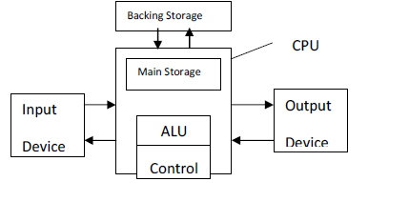
Definition
INTRODUCTION TO COMPUTER
WHAT IS COMPUTER?
A Computer is a device or set of devices that work under the control of a stored program, automatically accepts and processes data to provide information.
A computer accepts and then processes input data according to the instructions it is given. The
elements of any sort of processing are INPUT, PROCESSING, STORAGE, and OUTPUT
5

Slide 6
Definition
Computing: The process of utilizing computer technology to complete a task.
Computing may involve hardware and/or software, but must involve some form of a computer system.
Most Individuals use some form of computing everyday e.g. sending e-mail, telemedicine, business transaction and many more.
6

Slide 7
Definition
Computing includes:
designing, developing and building hardware and software systems;
designing a mathematical sequence of steps known as an algorithm;
processing, structuring, and managing various kinds of information;
performing scientific research on and with computers; making computer systems behave intelligently and many more.
7

Slide 8
Definition
The field of computing includes :
Computer engineering,
Software engineering,
Information systems,
Information technology and
Computer science,
Computer science : is the study of the theory, experimentation, and engineering that form the basis for the design and use of computers.
8

Slide 9
History of Computer Science and their generations.
History of computer development is often mentioned in reference to different generations of computing devices.
Each generation of computer is characterized by a major technological development that fundamentally changed the way computers operate,
resulting in increasingly smaller, cheaper, more powerful, more efficient and reliable devices.
9

Slide 10
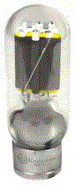
History of Computer Science and their generations.
First Generation (1940-1956)
- Used vacuum tubes for circuitry and magnetic drums for memory
- Very Big
- Very expensive
- Consumes electricity
- Generate a lot of heat
- They relied on machine language for performance
- Solve one problem at a time
- Input was based on punched cards and paper tape
10

Slide 11
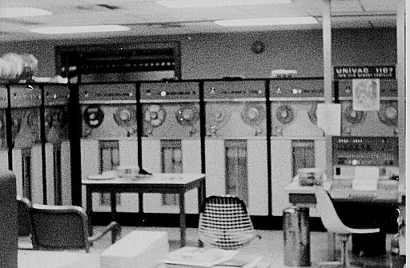
History of Computer Science and their generations.
Universal Automatic Computer (UNIVAC) - 1951
- First fully electronic digital computer built in the U.S.
- Created at the University of Pennsylvania
ENIAC(Electronic Numerical Integrator And Calculator )
First general –purpose computer
weighed 30 tons
contained 18,000 vacuum tubes
11

Slide 12
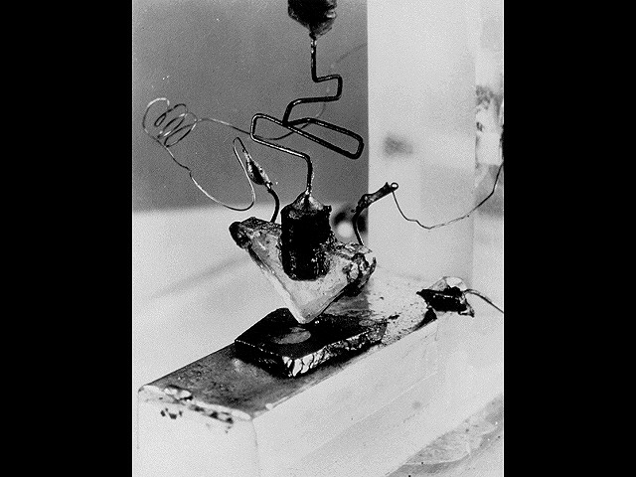
History of Computer Science and their generations.
Second Generation – 1965-1963
1956 – Computers began to incorporate Transistors
Replaced vacuum tubes with Transistors
12

Slide 13
History of Computer Science and their generations.
Second Generation (1956-1963)
- They used Transistors
- Smaller, faster, cheaper and more energy efficient computers
- Still relied on punched cards for input and output
- Transition from binary machine language to symbolic or assembly language
- High level programming languages were also developed, such as BASIC, COBOL and FORTRAN
- The first set of computer that stored their instruction on memory
13

Slide 14
History of Computer Science and their generations.
Third Generation – 1964-1971
Development of Integrated Circuit
Integrated Circuits are transistors, resistors, and capacitors integrated together into a single “chip”
Interaction through keyboards and mouse.
Smaller and Cheaper Computers.
Development of Operating System(OS)
OS is the set of programs that controls a computer.
14

Slide 15
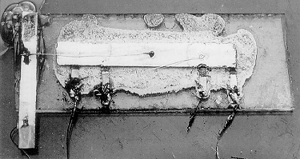
History of Computer Science and their generations.
Third Generation – 1964-1971
Integrated Circuit
15

Slide 16
History of Computer Science and their generations.
Fourth Generation – 1971-present
Availability of microprocessor
Thousands of integrated circuits were built onto a single silicon chip
Intel 4004 chip and IBM computers introduced
Smaller computers were linked together to form networks
This development led to Internet
Development of Graphical User Interface (GUI)
16

Slide 17
History of Computer Science and their generations.
Very Large Scale Integrated Circuit (VLSIC)
Transistors, resistors, and capacitors
4004 had 2,250 transistors
Pentium IV has 42 MILLION transistors
17

Slide 18
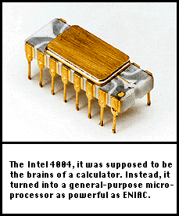
History of Computer Science and their generations.
The First Microprocessor (Intel 4004)– 1971
The 4004 had 2,250 transistors
four-bit chunks (four 1’s or 0’s)
108Khz
Called “Microchip”
18

Slide 19
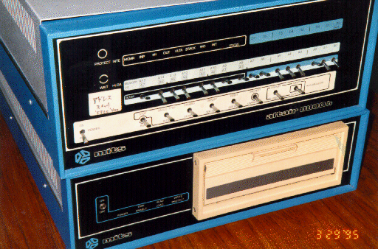
History of Computer Science and their generations.
Birth of Personal Computers(MITS Altair) - 1975
256 byte memory (not Kilobytes or Megabytes)
2 MHz Intel 8080 chips
Just a box with flashing lights
cost $395 kit, $495 assembled.
19

Slide 20
History of Computer Science and their generations.
Generations of Electronic Computers
20

Slide 21
History of Computer Science and their generations.
Evolution of Electronics
Microchip (VLSIC)
Integrated Circuit
Transistor
Vacuum Tube
21

Slide 22
History of Computer Science and their generations.
Fifth Generation (Present and Beyond)
Based on Artificial Intelligence
With the use of voice recognition, processing and super conductors
Parallel processing and super conductors which is helping to make artificial intelligence a reality.
Quantum computation, molecular technology will radically change the face of computers in years to come.
The goal is to develop devices that will respond to natural language and capable of learning.
22

Slide 23
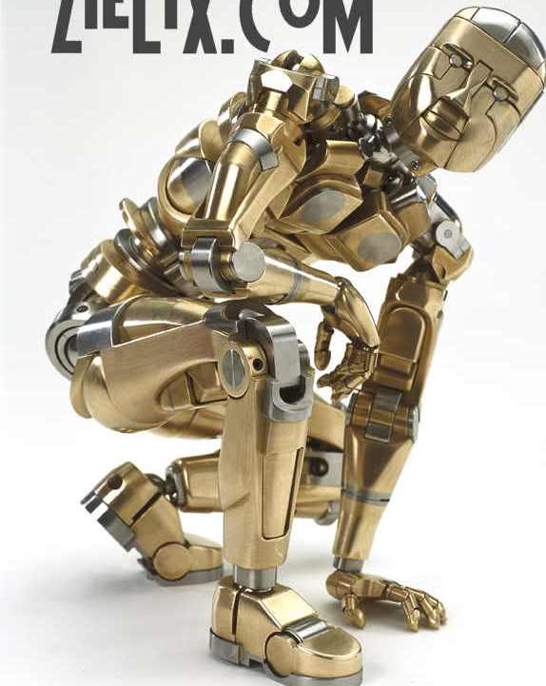
History of Computer Science and their generations.
Fifth Generation (Present and Beyond) Artificial Intelligence
23

Slide 24
CSC 101 : Introduction to Computer Science
WEEK 2
Notes:
24

Slide 25
Types, Classification and Characteristics of Computer System
Computer can be classified into the following:
Representation of numbers
Size
- Purpose
25

Slide 26
Types, Classification and Characteristics of Computer System
Representation of numbers
Digital computers – They store or represent information in binary (digital) form
Analogue computers – They represent information using physical quantities
Hybrid computers – They combine analogue and digital computers’ properties
26

Slide 27
Types, Classification and Characteristics of Computer System
Classification by size
Super computer
Mainframe computer
Mini computer
Micro computer – personal computer (PC)
27

Slide 28
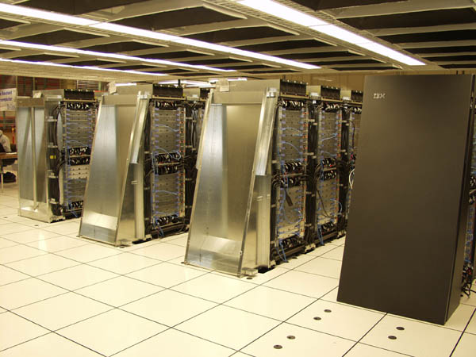
Classification of Computer by Size.
Supercomputer
28

Slide 29
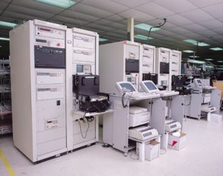
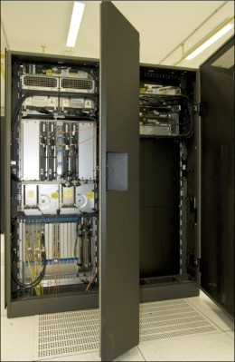
Classification of Computer by Size.
Mainframe Computer
29

Slide 30
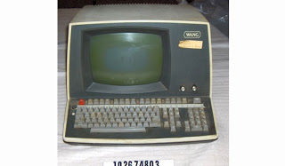
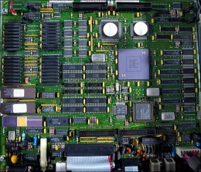
Classification of Computer by Size.
Minicomputer
30

Slide 31
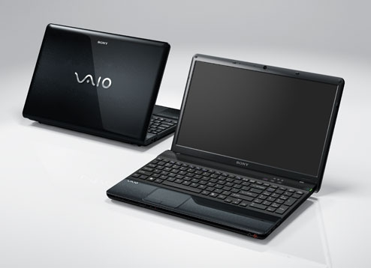
Classification of Computer by Size.
Micro-computer
31

Slide 32
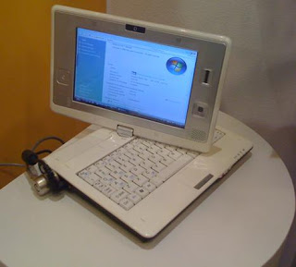
Classification of Computer by Size.
Micro-computer
32

Slide 33
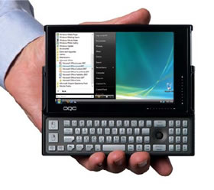
Classification of Computer by Size.
Micro-computer
33

Slide 34
Types, Classification and Characteristics of Computer System
C) Classification by Purpose
Special purpose computers – designed for particular job or task to solve problems
General purpose computer- designed to solve a wide variety of problems and can be used to carry out different jobs.
34

Slide 35
Types, Classification and Characteristics of Computer System
Characteristics of Computers
Speed
Capacity
Versatility- it can be used for many things
Diligence
Accuracy
Automatic
35

Slide 36
Benefit of Computer System
Computer can be used in the following areas of life:-
Engineering,
Science,
Health,
Marketing,
Security,
Education,
Management,
Production, etc.
36

Slide 37
COMPUTER SYSTEMS
HARDWARE
SOFTWARE

Slide 38
Hardware
Hardware is the physical part of the computer that can be seen,
touched or handled.
The hardware consists of the physical and
internal components of the system.
The Hardware has the following basic components:
Input Unit
The Central Processing Unit
Storage Unit
Output Unit

Slide 39
(1) INPUT UNIT
An input device is the main source by which
computer receive information.
It is the Electro-mechanical system, which aids
the transferring of data into the computer,
that is, it is the medium through which data
can be supplied to the computer

Slide 40
(1) INPUT UNIT
Examples are:
a) Keyboard b) Mouse c) Joystick d) Trackball
e) Light Pen and Stylus f) Graphic Tablet or Digitizer
Touch Screen h) Scanner i) Magnetic Tapes and Cassettes Readers
Audio input units or Voice Data Entry (VDE)
k) Computer Disk and DVDs Readers
l) Floppy and Hard Disk drives

Slide 41
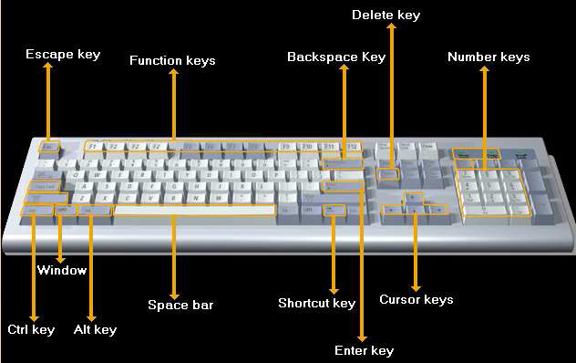
A KEYBOARD

Slide 42
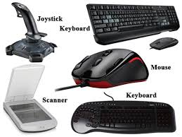
INPUT DEVICES.
42

Slide 43
INPUT DEVICES.
Body Scanners
CT (computerized tomography' (CT) (or 'computerized axial tomography' (CAT) scan)scanners and MRI scanners allow doctors to investigate what is happening inside a patient's body without intrusive surgery.
43

Slide 44
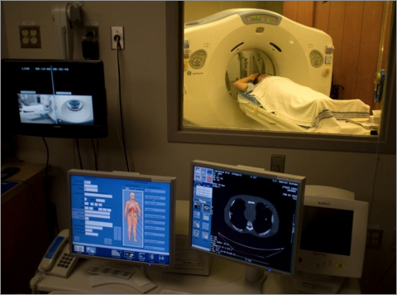
INPUT DEVICES.
Body Scanners
44

Slide 45
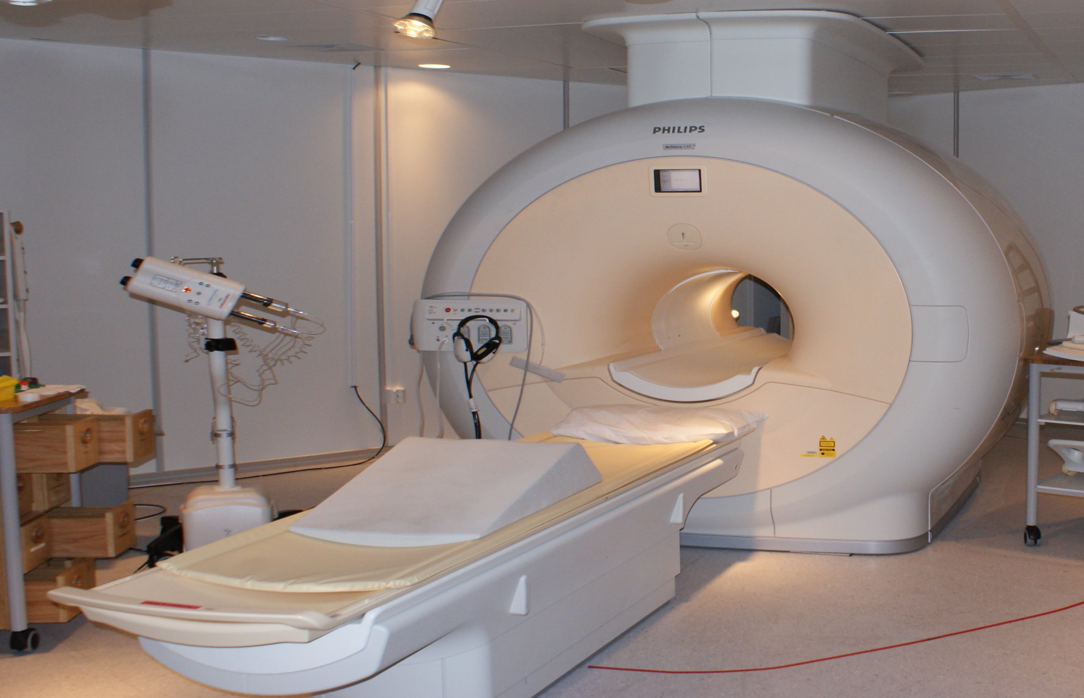
MAGNETIC RESONANCE IMAGING(MIR)
.
45

Slide 46
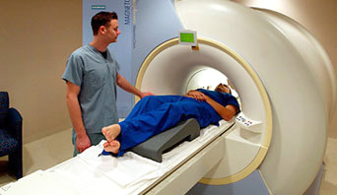
MAGNETIC RESONANCE IMAGING(MIR)
.
46

Slide 47
(2) CENTRAL PROCESSING UNIT (CPU)
This is otherwise known as the heart of the computer. Where
- all manipulations are done,
- main operation is being carried out.
It stand between the input and output devices.
It receives incoming data and instructions,
works upon the data and sends to destination unit
I t consists of the arithmetic and logic unit, the control unit
and the memory unit.
It performs most of the calculations within the computer

Slide 48
CPU (CONTD)
responsible for the smooth running of your operating system
as well as your application programs, such as word processors,
spreadsheets and databases.
A small amount of memory associated with the CPU is used to
perform these operations.
It also accesses and uses the main memory (RAM - Random
Access Memory) within your computer.
- is the single most important item within your computer that
governs the overall speed of your computer.
The CPU's speed is measured in MHz, the higher theMHz
rating of your CPU the faster your computer will run
-

Slide 49
The System (Mother) Board
contained within the System unit
all vital computer part are plugged directly to the system board.
Other items such as the hard disk are attached to the system board,
either directly or via cables.
These boards are getting smaller and smaller as the
components become more integrated

Slide 50
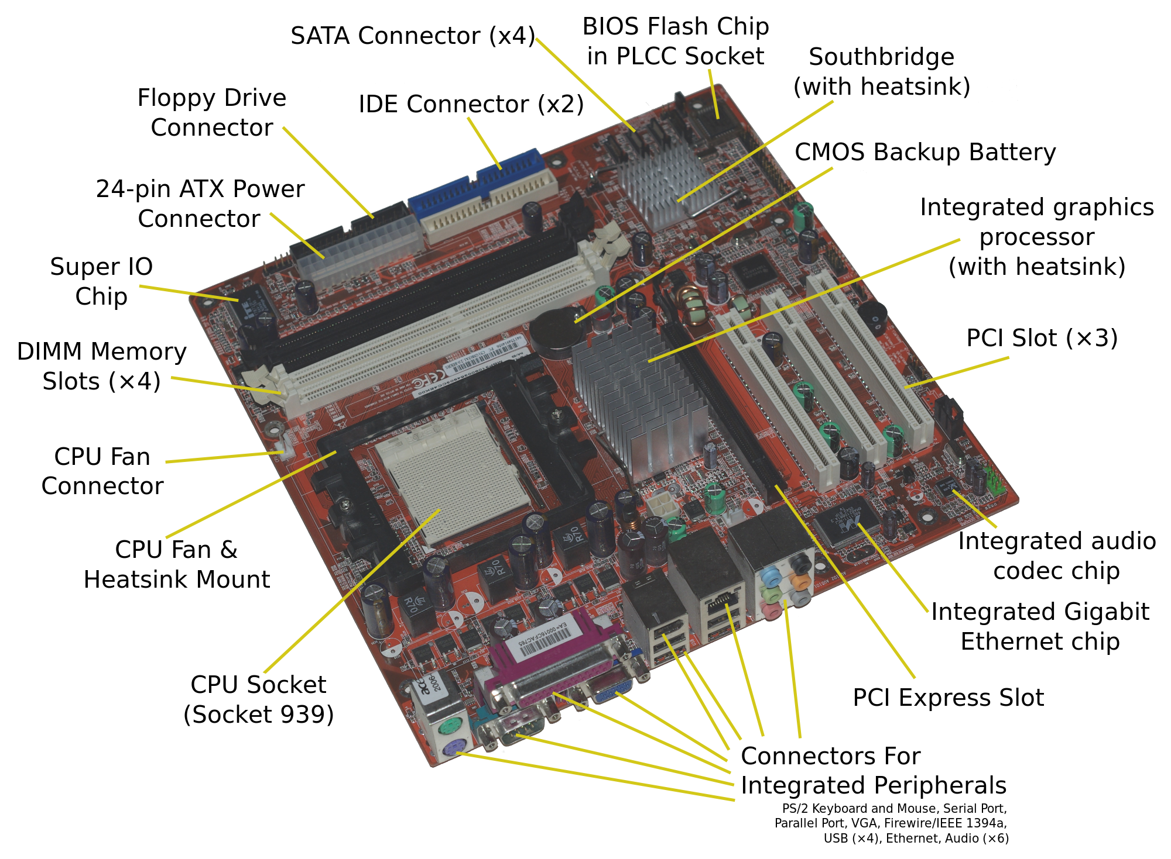

Slide 51
MAIN MEMORY
The main memory is also called Internal storage or primary storage/memory.
The Internal memory of a computer is an integral element of the
processing unit and may be referred to as the computer’s working memory.
It is used for storing software in the form of operating system, application
programs and utility routines, etc.
Internal storage has to be complimented by external storage, that is,
storage external to the processor, which is referred to as
“BANKING STORAGE”.
This is used for mass storage whereas storage is used for immediate
access requirements.

